Slide 1
Micah
Nahum
Jonah
Habakkuk
Minor Prophets
Obadiah
Zephaniah
Amos
Haggai
Joel
Zechariah
Hosea
Malachi
1
1
1
1
1
1
1
1
1

Slide 2
Habakkuk

Slide 3
Introduction to the book of Habakkuk
Habakkuk (chabhaqquq) means "embrace,“
The church fathers think that He was from the tribe of Levi based upon the presence of the musical song at the end of the third chapter.
He lived during the rule of King Jehoiakim
The Prophecies of Habakkuk were probably written between B.C. 612 -605
Notes:
Determining the date of the book of Habakkuk is quite a bit easier than dating most books. He spoke often of an imminent Babylonian invasion (Habakkuk 1:6; 2:1; 3:16), an event that occurred on a smaller scale in 605 BC before the total destruction of Judah’s capital city, Jerusalem, in 586 BC. The way Habakkuk described Judah indicates a low time in its history. If the dating is to remain close to the Babylonian invasion, Habakkuk likely prophesied in the first five years of Josiah reign (609–598 BC) to a king who led his people into evil.

Slide 4
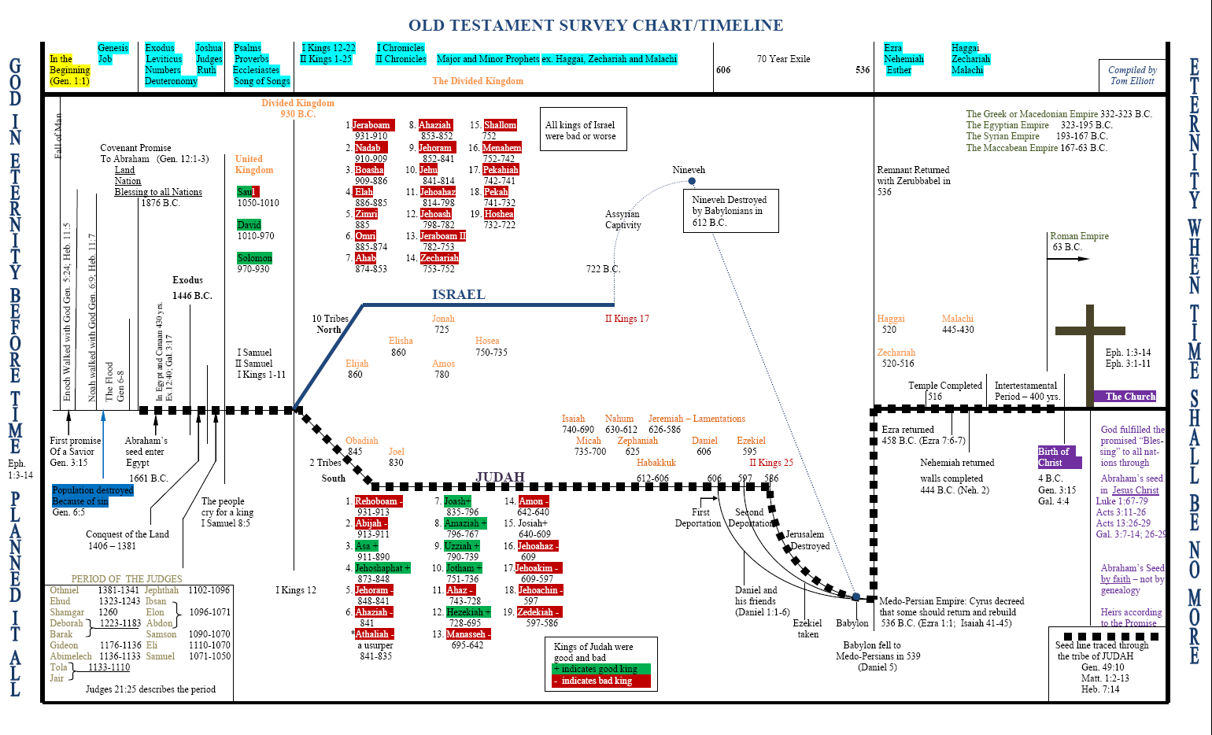
Notes:
i. It’s hard to say with certainty when Habakkuk prophesied. Since he speaks of God raising up the Babylonians (Habakkuk 1:6), we can guess that he wrote in the 25-year period between the time when Babylon conquered Nineveh and the Assyrian Empire (612 B.C.) and the time when Babylon conquered Jerusalem (587 B.C.).
ii. We don’t know how old Habakkuk was when he gave this prophecy, but it is likely that he lived during the time of godly king Josiah (640 to 609 B.C.) and then gave this prophecy during the reign of one of Josiah’s successors. Habakkuk knew what it was like to live during a time of revival, and then to see God’s people and the nation slip into lethargy and sin. “Habakkuk had a problem. He had lived through a period of national revival followed by a period of spiritual decline” (Boice).

Slide 5
Chapter 1
(V 1 -5) Habakkuk complained about the violence and he questioned God for the injustice towards the people of Israel.
V (6 – 11 ) God answered by letting Habakkuk prophesy
(V 12 -17) Again the prophet appeal to God ,Now that he is aware of the punishment But still questioning how God is holy, yet allows this punishment by the hand of wicked people
Notes:
Habakkuk looked at the violence and injustice around him in the nation of Judah. He wondered where God was, and why God did not set things right.
God’s astounding work: bringing the Babylonians to judge Judah.
Habakkuk was first troubled that there was no judgment against Judah; God answered by telling him judgment was on the way. Then Habakkuk was troubled by the agent of judgment, the Babylonians – who were an even more wicked people than the people of Judah.

Slide 6
Chapter 2
Habakkuk must wait in faith.
Judgments upon the Chaldeans.
Judgments upon drunkenness and idolatry.
Notes:
Same like what Habakkuk did we must observe the answers God gives by his word, his Spirit, and providences; what the Lord will say to our case. God will not disappoint the believing expectations of those who wait to hear what he will say unto them.
The first Curse upon the pride of life.
The second curse is upon all which was gained by fraud and injustice.
The third curse is upon sinner thinks he has managed his frauds and violence.
The fourth is upon Satan to convince Gods people to commit sins.
The fifth is upon the Idol worshipers.

Slide 7
Chapter 3
Habakkuk’s Prayer
Habakkuk prayed for revival. He knew how God once worked and how His people once responded.
Habakkuk wanted to witness this again.
Notes:
The prayer of Habakkuk shows us that revival is a work of God, not the achievement of man. There is something man can and must do for revival – simply cry out to God and plead for His reviving work.
Verse 4 “but the righteous person will live by his faithfulness” the heart of the prophecy

Slide 8
Important service lessons learned from Habakkuk
The servant heart is always open to God carrying his own burdens along with his children problems and put them infront of God until he realize God purpose and solutions.
The servants heart should be open towards his children .The servant should feel their pain and suffering.
With a Joyful heart the servants should always react despite all the trouble.
Notes:
نجد هنا صفات الخادم الحقيقي:
أ‌. ‌قلب مفتوح أمام الله، حاملًا همومه وهموم مخدوميه داخلًا بها مخدعه طارحًا إياها أمام الله، ثم يخرج وفي قلبه عزاء وثقة.
ب‌. ‌قلب مفتوح نحو المخدومين. فهو لم يحتمل آلام شعبه بالرغم من أنهم يستحقونها.
ت‌. قلب مملوء فرحًا وتسبيحًا، ورؤية للمستقبل الذي فيه يتمجد الله

Slide 9
Jonah

Slide 10
Introduction to the book of Jonah
The book of Jonah is an announcement from God enforcing the acceptance of the gentiles and glimpse of his messages to them. We understand that God reveals himself to everyone not to certain people.
Jonah’s name means “dove” in Hebrew and also suffering
He is believed to be the son of Widow at Zarephath1 Kings 17

Slide 11
Introduction to the book of Jonah
Jonah lived in the eighth century BC. Some have estimated between 793-753 BC (possibly 780 BC).
The book of Jonah is prophetic work that is unlike any of the other prophets. The genre is historical literature. The book is surrounded by historical data: Jonah was a historical person, Nineveh was a historical city, the seaport of Joppa has historical significance, etc. There is no reason to doubt its historical value, no matter how magical the story might seem to the reader.

Slide 12
Introduction to the book of Jonah
. Ninevah was the capital of Assyria, the arch rivals and enemies of Israel
We learn from the book of Jonah that God is orchestrating the nature, the sea , the animals, trees to achieve a mission
Jesus referred to the story of Jonah in Matthew 12:39

Slide 13
Chapter 1
Jonah Flees From the Lord. Why?
Jonah went down to Joppa then gone below deck (Jonah kept on drowning in his sin to the extent that he never noticed the trouble surrounding him any more)
Gentile mariners praying to their gods woke Jonah up and they asked him to pray to his God so that they could be saved
Notes:
1. Ninevah was the capital of Assyria, the arch rivals and enemies of Israel.
2. They were cruel, blood thirsty people, the worst in the land. - History says they would peel peoples skin off and put them up on posts in the cities for all to see. They would stack hundreds of skulls outside the city gates. They would chain people around the neck and take them into slavery.
3. If Jonah was familiar with other prophets he would have known that they were the one prophesied to bring Israel into captivity.
4. The most important reason was that he hated these people and he did not want to give them God’s message because he wanted to see them die.

Slide 14
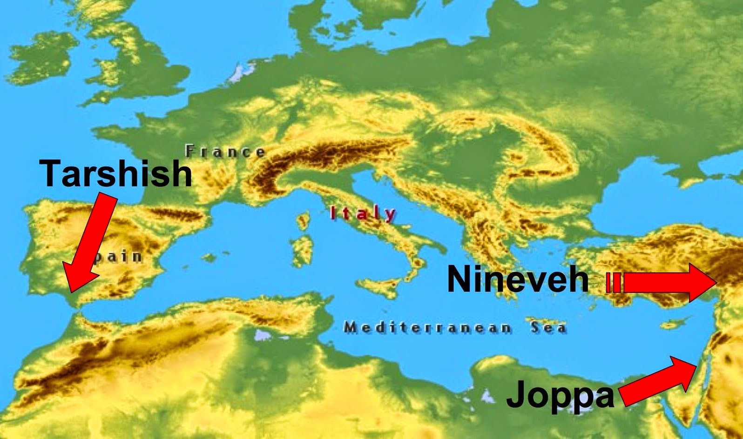

Slide 15
Chapter 2
Jonah is Praying in the Great Fish (2:1-9)
The prayer of Jonah is a prophecy of Jesus crucifixion.
God has finally put His prophet in the place where he would seek His face and submit himself to Him.

Slide 16
Chapter 3
Jonah Goes to Nineveh. He took 3 days to arrive after the fish vomited him onto dry land.
The people of Nineveh were ready for Jonah’s evangelistic message.
They proclaimed a fast, put on sackcloth, and sat in ashes and dressed coarse cloth, dark in color, that was usually made of goat’s hair
God’s evaluated Ninevites’ faith and it was strong enough to persuade God not to destroy them

Slide 17
Chapter 4
The repentance was good news to Nineveh, but bad news to Jonah.
instead of being pleased with what happened, and praising God for His grace to Nineveh and for the success of his ministry, Jonah was displeased exceedingly and very angry with what God had done
God prepared a plant and made it come up over Jonah.
Jonah sat under a shelter he watched the city.
As the morning dawned the next day God prepared a worm.
Notes:
a. The prophet admits that he feels God is wrong for what he is doing. - How many times have you done this to God?
b. On the same hand he recognizes God is gracious, merciful, slow to anger, abundant in lovingkindness, and relents from doing harm. c. This proves to us that the reason he didn’t want to go to Ninevah is because he wanted them to perish.

Slide 18
Chapter 4
Jonah was concerned over a temporary plant.
This was a plant without a soul.
He had no concern over the great city of Nineveh.
This city had a population of more than 120,000 souls (v.11).

Slide 19
Important service lessons learned from Jonah
Jonah was not expecting God’s mission for him “A Godly prophet to preach Gentiles” Sometimes as servants we are called for a service out of our scope and we feel that this service is not for us.
We need to be watchful to avoid missing God’s clear messages to us . It is easier to have our ears open than to get swollen by a fish ☺
Jonah was not ready to learn lessons from others ( sailors , Ninevites, worm)
Jonah witnessed miracles once he started God’s work not because of his own powers but through God’s glory.

Slide 20
Joel

Slide 21
Introduction to the book of Joel
Who? The author of the book is Joel the son of Pethuel (Joel means Jehovah is his God)
When? It is not known exactly when Joel lived and prophesied to the kingdom of Judah
He may have lived sometime between the reign of Joash, before 850 B.C. and the return of the tribe of Judah from captivity in Babylon and some other says that he lived around 400 BC in Jerusalem.
Purpose : Calling for repentance and receiving the receive the Holy Spirit
Notes:
We are altogether uncertain concerning the time when this prophet prophesied but God sent a variety of prophets, that they might strengthen the hands one another, and that out of the mouth of two or three witnesses every word might be established. In this prophecy,

Slide 22
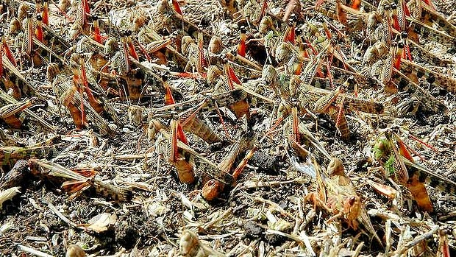
Chapter 1
Verses 1 -12
An Invasion of Locusts explains how if we ignore small sins , it brings bigger sins which causes destruction.
God warnings comes in stages.
The greatness of Judgment.
A nation has invaded my land.
Waste my vines
Ruined my fig trees

Slide 23
Chapter 1
Verses 13 -15
A call for repentance.
The prophet is addressing the clergy and the servants as this is where repentance should start.
Verses 16 -20
Describing the signs of suffering as a result of the people sins

Slide 24
Chapter 2
Verses 1 -12
A very strong army coming to attack as a discipline from God.
Verses 12 -20
The repentance act God is expecting from his people.
Verses 21 – 32
It was revealed to the prophet how people will rejoice after God’s forgiveness. Describes the fruits of the spirit (same verses St. Peter used in Act 2 -17).

Slide 25
Chapter 3
Verses 1 - 8
After they repented God turn against the nations whom he allowed to discipline his children.
Valley of Jehoshaphat = God’s Judgment Valley
Verses 9 -17
With God’s grace his people can defeat their enemy (Let the weakling say, “I am strong!”)

Slide 26
Chapter 3
Verses 18-
Blessings for God’s People.
Valley of acacias. = means the dry land which was ruined by the Locusts and the enemies.
Egypt and Edom = represent the devil.
Egypt → the love of the world
Edom → the violence and bloodshed

Slide 27
Important service lessons learned from Joel
The timing of the prophecy is unknown which makes it applicable for all times not sent for certain period .
The important message is that :The days are near hence without Jesus and the Holy spirit people will be in distress but God’s people will be in peace despite all the trouble as the holy spirit will be guiding us and talking to us (Read John 16 -13)

Slide 28
Important service lessons learned from Joel
Joel 2 -18 Then the Lord was jealous for his land and took pity on his people. The prophet in this verse is describing God’s feelings towards his people and the land . Servants land is the service and the people we should have pity for are our kids.
Joel 3 -10 Let the weakling say, “I am strong!” Always remember in your service that its not your own words or your own powers that you are depending on but God’s grace.

