Slide 1
Micah
Nahum
Jonah
Habakkuk
Minor Prophets
Obadiah
Zephaniah
Amos
Haggai
Joel
Zechariah
Hosea
Malachi
1
1
1
1
1
1
1
1
1

Slide 2
Habakkuk

Slide 3
Introduction to the book of Habakkuk
Habakkuk (chabhaqquq) means "embrace,“
The church fathers think that He was from the tribe of Levi based upon the presence of the musical song at the end of the third chapter.
He lived during the rule of King Jehoiakim
The Prophecies of Habakkuk were probably written between B.C. 612 -605
Notes:
Determining the date of the book of Habakkuk is quite a bit easier than dating most books. He spoke often of an imminent Babylonian invasion (Habakkuk 1:6; 2:1; 3:16), an event that occurred on a smaller scale in 605 BC before the total destruction of Judah’s capital city, Jerusalem, in 586 BC. The way Habakkuk described Judah indicates a low time in its history. If the dating is to remain close to the Babylonian invasion, Habakkuk likely prophesied in the first five years of Josiah reign (609–598 BC) to a king who led his people into evil.

Slide 4
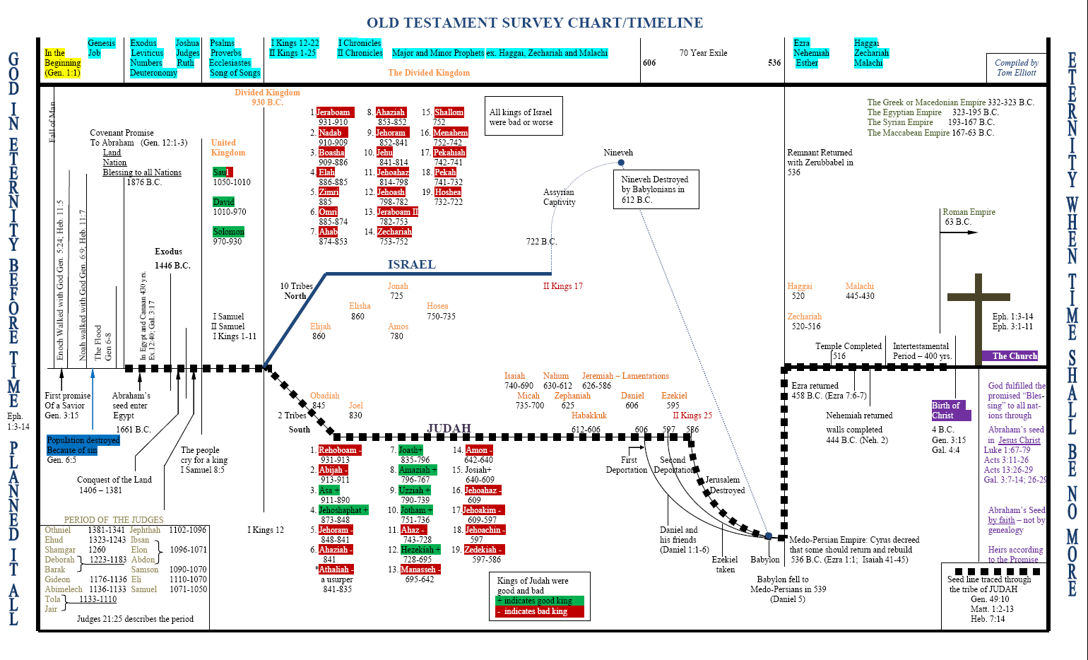
Notes:
i. It’s hard to say with certainty when Habakkuk prophesied. Since he speaks of God raising up the Babylonians (Habakkuk 1:6), we can guess that he wrote in the 25-year period between the time when Babylon conquered Nineveh and the Assyrian Empire (612 B.C.) and the time when Babylon conquered Jerusalem (587 B.C.).
ii. We don’t know how old Habakkuk was when he gave this prophecy, but it is likely that he lived during the time of godly king Josiah (640 to 609 B.C.) and then gave this prophecy during the reign of one of Josiah’s successors. Habakkuk knew what it was like to live during a time of revival, and then to see God’s people and the nation slip into lethargy and sin. “Habakkuk had a problem. He had lived through a period of national revival followed by a period of spiritual decline” (Boice).

Slide 5
Chapter 1
(V 1 -5) Habakkuk complained about the violence and he questioned God for the injustice towards the people of Israel.
V (6 – 11 ) God answered by letting Habakkuk prophesy
(V 12 -17) Again the prophet appeal to God ,Now that he is aware of the punishment But still questioning how God is holy, yet allows this punishment by the hand of wicked people
Notes:
Habakkuk looked at the violence and injustice around him in the nation of Judah. He wondered where God was, and why God did not set things right.
God’s astounding work: bringing the Babylonians to judge Judah.
Habakkuk was first troubled that there was no judgment against Judah; God answered by telling him judgment was on the way. Then Habakkuk was troubled by the agent of judgment, the Babylonians – who were an even more wicked people than the people of Judah.

Slide 6
Chapter 2
Habakkuk must wait in faith.
Judgments upon the Chaldeans.
Judgments upon drunkenness and idolatry.
Notes:
Same like what Habakkuk did we must observe the answers God gives by his word, his Spirit, and providences; what the Lord will say to our case. God will not disappoint the believing expectations of those who wait to hear what he will say unto them.
The first Curse upon the pride of life.
The second curse is upon all which was gained by fraud and injustice.
The third curse is upon sinner thinks he has managed his frauds and violence.
The fourth is upon Satan to convince Gods people to commit sins.
The fifth is upon the Idol worshipers.

Slide 7
Chapter 3
Habakkuk’s Prayer
Habakkuk prayed for revival. He knew how God once worked and how His people once responded.
Habakkuk wanted to witness this again.
Notes:
The prayer of Habakkuk shows us that revival is a work of God, not the achievement of man. There is something man can and must do for revival – simply cry out to God and plead for His reviving work.

Slide 8
Important service lessons learned from Habakkuk
The servant heart is always open to God carrying his own burdens along with his children problems and put them infront of God until he realize God purpose and solutions.
The servants heart should be open towards his children .The servant should feel their pain and suffering.
With a Joyful heart the servants should always react despite all the trouble.

